Slide 1
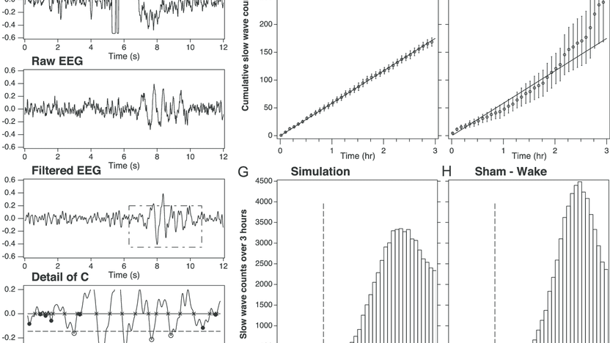
EG431D Data Acquisition
Pre-Processing and Filtering

Slide 2
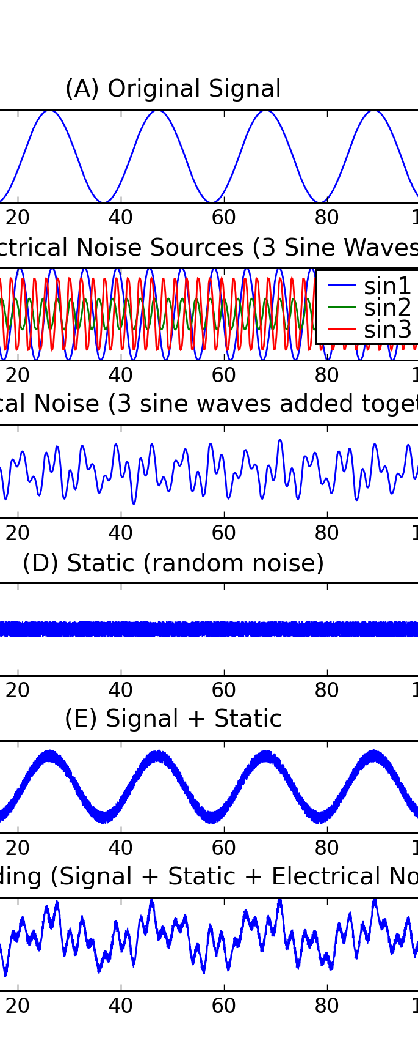
Objectives
Understand the purpose of signal pre-processing techniques.
Learn methods to reduce noise and prepare signals for analysis.
Explore filtering techniques for frequency isolation.
Apply these methods in real-world applications like audio processing, communication systems, and biomedical analysis.

Slide 3

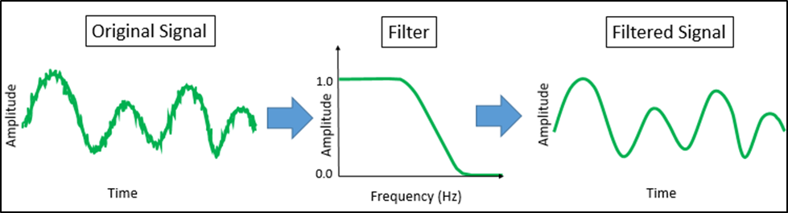
Introduction to Pre-Processing and Filtering
Pre-Processing: Enhances signal quality, reduces noise.
Filtering: Isolates or removes specific frequency components.
Common techniques:
Normalization, scaling, smoothing, and transformation.
Low-pass,high-pass, band-pass, band-stop.

Slide 4
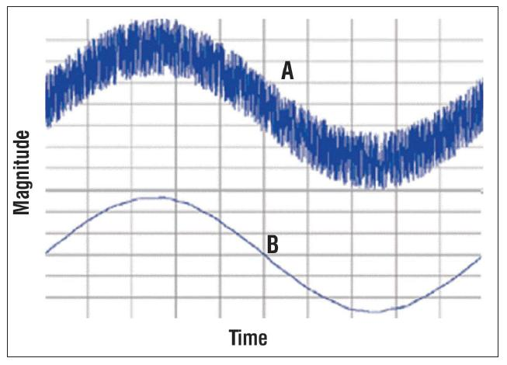
Pre-Processing Techniques
Normalization: Aligns data scales for comparability.
Scaling: Adjusts signal amplitude for compatibility.
Smoothing: Reduces noise while retaining trends.
Transformation: Converts signals for specific analyses (e.g., Fourier Transform).

Slide 5
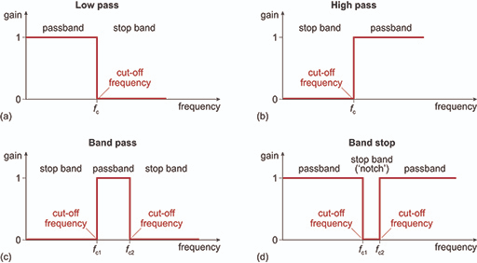
Filtering Techniques
Low-Pass Filters: Pass low frequencies; remove high-frequency noise.
High-Pass Filters: Pass high frequencies; remove low-frequency noise.
Band-Pass Filters: Isolate a specific frequency range.
Band-Stop Filters: Remove a narrow frequency range.

Slide 6

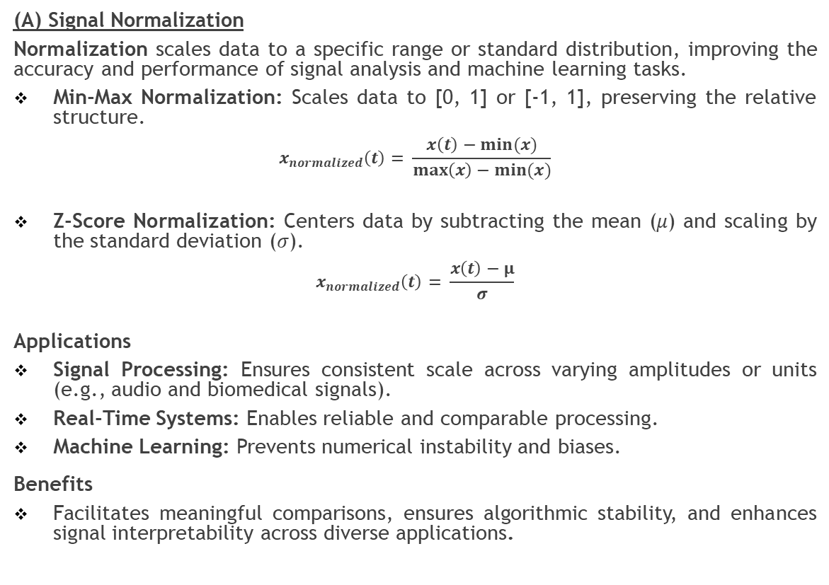
Digital Signal Pre-Processing
(A) Signal Normalization
Normalization scales data to a specific range or standard distribution, improving the accuracy and performance of signal analysis and machine learning tasks.
Min-Max Normalization: Scales data to [0, 1] or [-1, 1], preserving the relative structure.
$$x_{normalized}\left(t\right)= \frac{x\left(t\right)−min⁡(x)}{\max\left(x\right)−min⁡(x)}$$
Z-Score Normalization: Centers data by subtracting the mean (𝜇) and scaling by the standard deviation (𝜎).
$$x_{normalized}\left(t\right)= \frac{x\left(t\right)−μ}{σ}$$
Applications
Signal Processing: Ensures consistent scale across varying amplitudes or units (e.g., audio and biomedical signals).
Real-Time Systems: Enables reliable and comparable processing.
Machine Learning: Prevents numerical instability and biases.
Benefits
Facilitates meaningful comparisons, ensures algorithmic stability, and enhances signal interpretability across diverse applications.

Slide 7
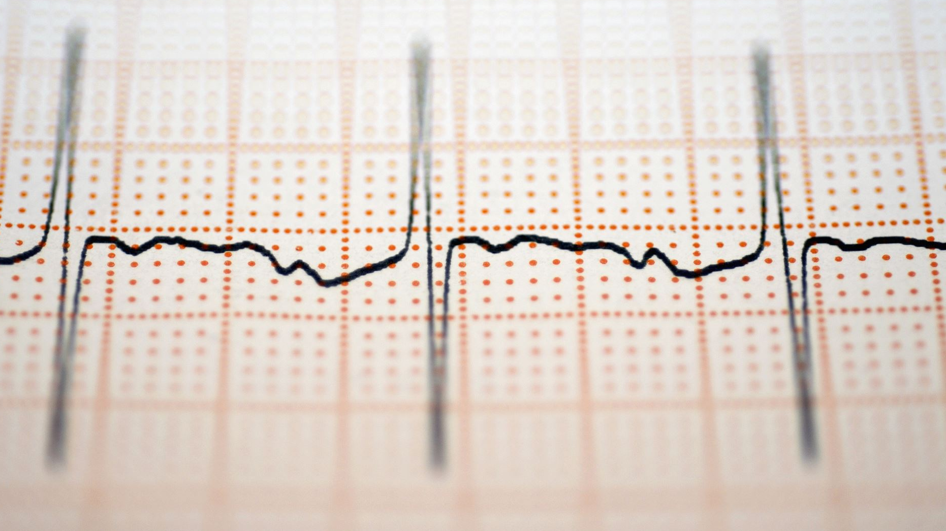
Digital Signal Pre-Processing
(B) Signal Scaling
Scaling adjusts a signal's amplitude or range to meet specific requirements, enhancing compatibility, performance, and feature emphasis across applications.
Min-Max Scaling: This method adjusts a signal, so its values lie within a specified range, often [0, 1] or [-1, 1].
Amplitude Normalization: The signal is scaled based on its maximum absolute value, often referred to as peak scaling.
Mean and Variance Scaling: This technique involves centering the signal around zero mean and scaling by its standard deviation, typically used in statistical analysis.
Logarithmic Scaling: This method applies a logarithmic transformation to compress dynamic ranges, especially useful for signals with large variations in amplitude, such as decibel scaling in audio processing.
Benefits
Improved compatibility with system input ranges.
Better numerical stability in algorithms, especially for machine learning.
Enhanced interpretability of signals by reducing extreme variations.

Slide 8
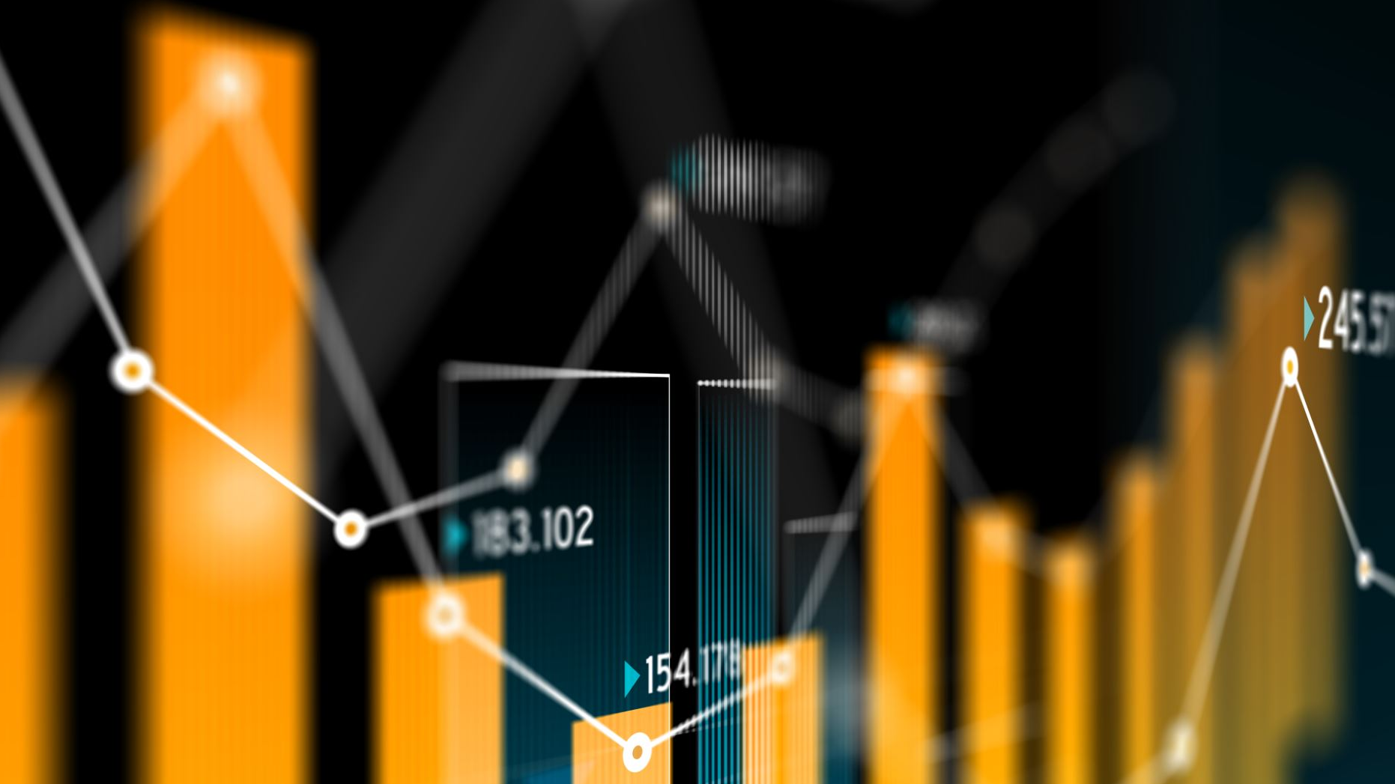
Digital Signal Pre-Processing
(C) Signal Smoothing
Smoothing reduces noise and fluctuations in signals while retaining important trends and features, enhancing interpretability and analysis.
Moving Average: Calculates the average over a window, reducing short-term noise.
Exponential Moving Average (EMA): Weights recent data more heavily, reacting quickly to changes.
Savitzky-Golay Filter: Fits a polynomial to preserve peaks and edges.
Low-Pass Filtering: Removes high-frequency noise, retaining trends.
Median Filtering: Replaces data points with the median in a window, effective against outliers.
Applications
Biomedical Signals: Noise reduction in ECG/EEG for accurate diagnoses.
Industrial Monitoring: Identifies gradual trends like machinery wear.
Data Visualization & Feature Extraction: Enhances clarity for advanced analysis.

Slide 9

Digital Signal Pre-Processing
(D) Signal Transformation
Signal Transformation converts signals between domains or modifies their structure to facilitate analysis, processing, or application-specific tasks.
Fourier Transform: Converts time-domain signals to the frequency domain.
Laplace Transform: Analyzes signals in the complex frequency domain.
Wavelet Transform: Provides time-frequency resolution for non-stationary signals.
Logarithmic & Exponential Transformations: Compress dynamic ranges or emphasize features.
Applications
Audio Processing: Identifying dominant frequencies for filtering and noise reduction.
Image Analysis: Edge detection and compression.
Machine Learning: Normalization and standardization for model training.
Speech & Music Analysis: Time-frequency representation with Short-Time Fourier Transform (STFT).

Slide 10
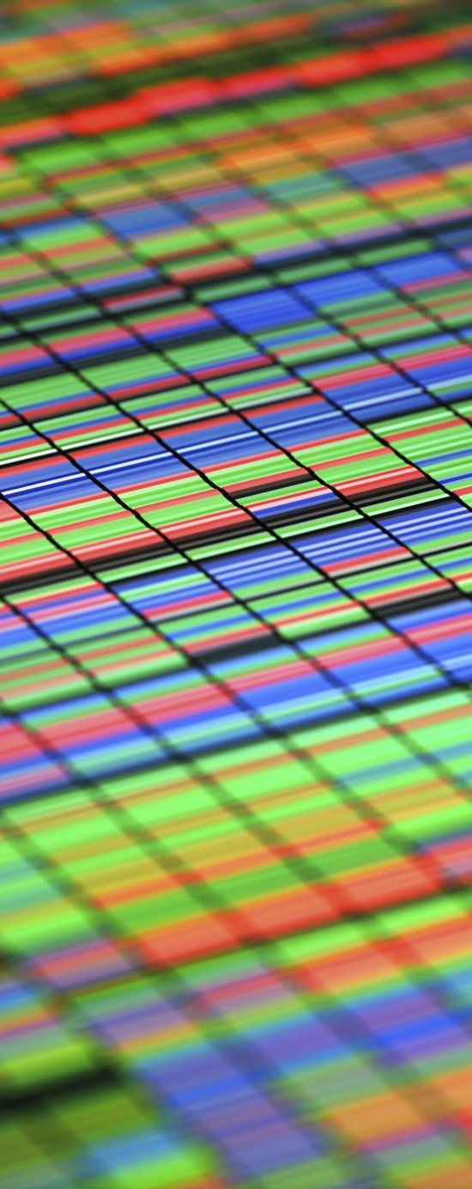
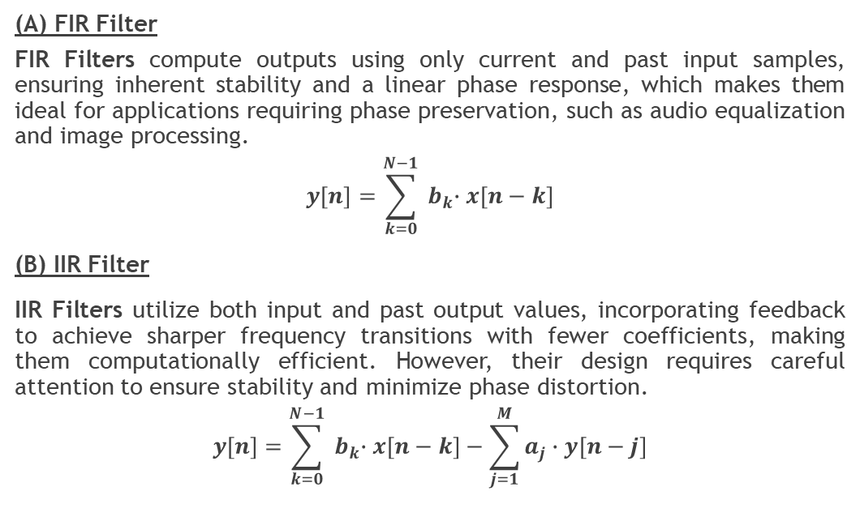
Digital Signal Filtering
(A) FIR Filter
FIR Filters compute outputs using only current and past input samples, ensuring inherent stability and a linear phase response, which makes them ideal for applications requiring phase preservation, such as audio equalization and image processing.
$$y\left[n\right]=\sum_{k=0}^{N−1}{{ b}_{k}∙x\left[n−k\right]}$$
(B) IIR Filter
IIR Filters utilize both input and past output values, incorporating feedback to achieve sharper frequency transitions with fewer coefficients, making them computationally efficient. However, their design requires careful attention to ensure stability and minimize phase distortion.
$$y\left[n\right]=\sum_{k=0}^{N−1}{{ b}_{k}∙x\left[n−k\right]−\sum_{j=1}^{M}{a_{j}∙y[n−j]}}$$

Slide 11
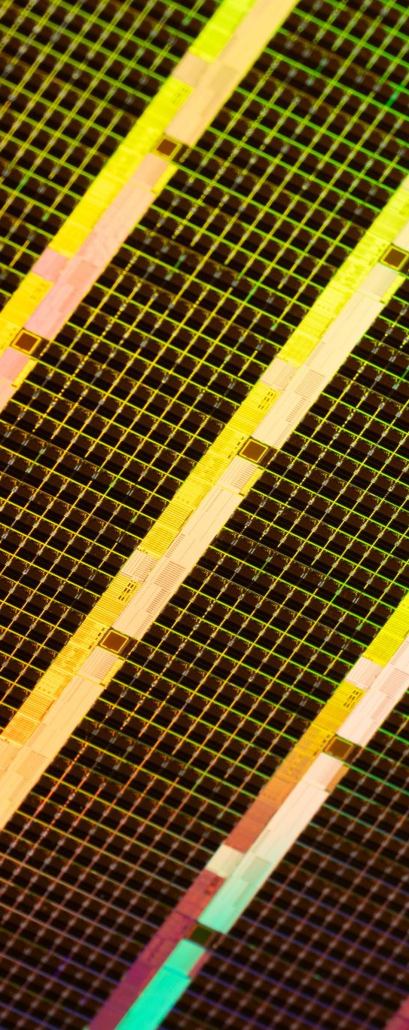
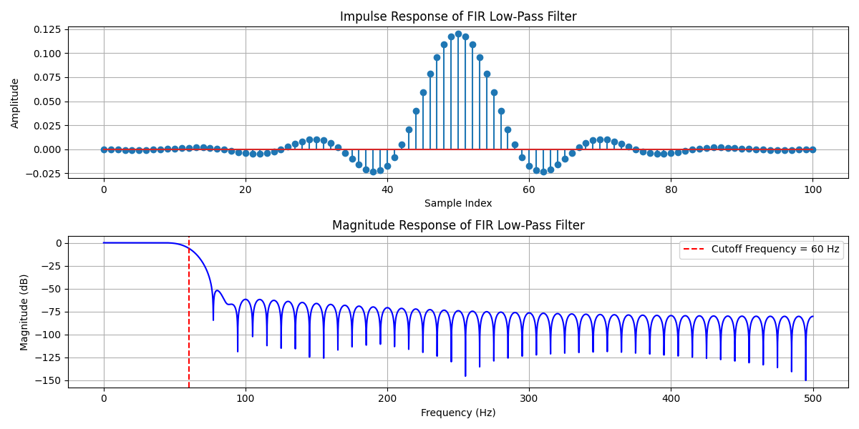
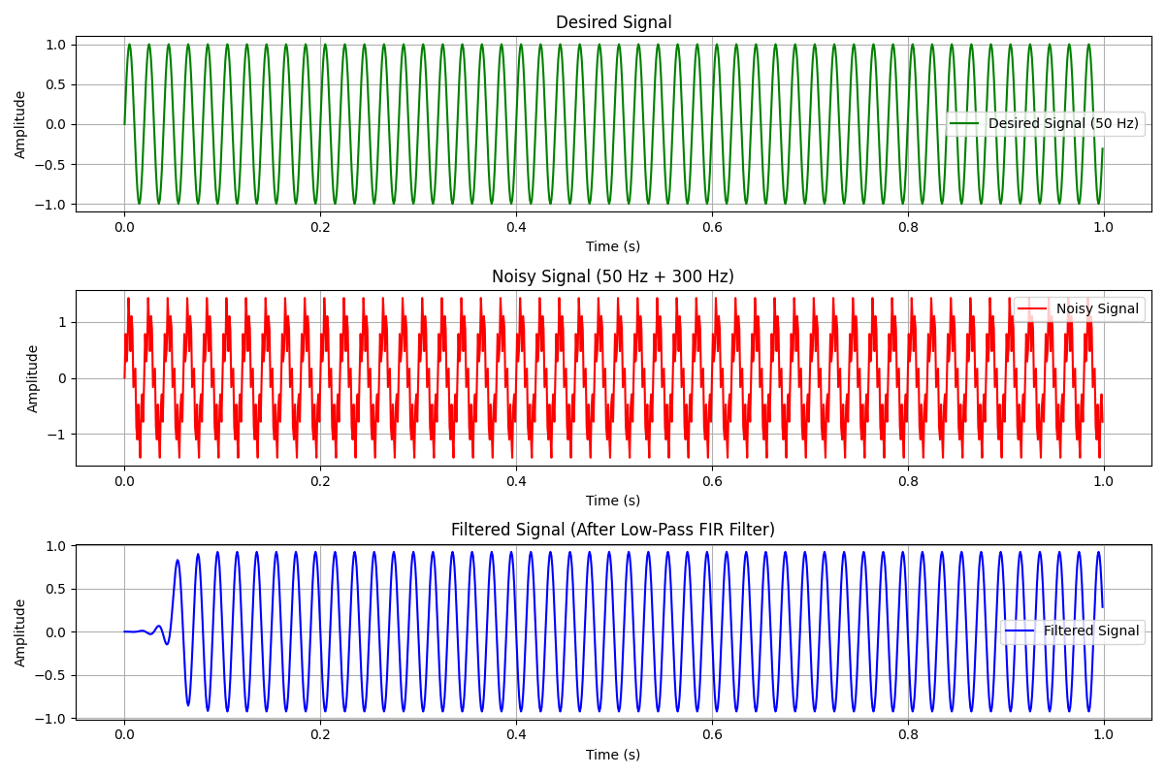
Digital Filter Design Example
A low-pass FIR filter is to be designed using window method with the following specification:
Cutoff frequency = 60 Hz (or 0.12 if normalized to Nyquist frequency)
Sampling rate = 1 kHz
Filter order = 101
Window type: Hamming window

Slide 12

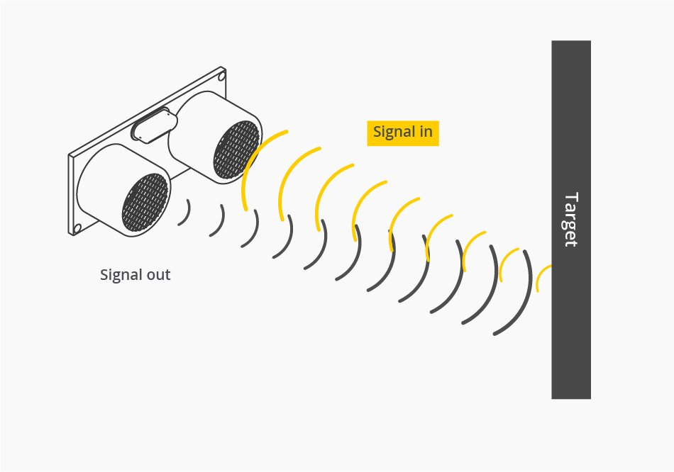
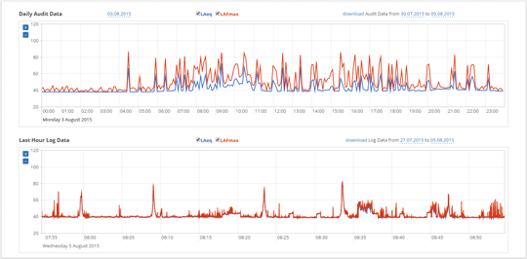
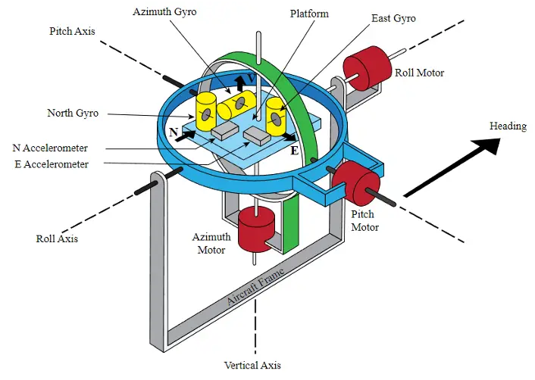
Practical Example with Arduino
Distance Sensing: Ultrasonic sensor data smoothing with moving average/median filters.
Sound Monitoring: FIR filters for noise reduction.
Inertial Navigation System: Kalman Filter.

Slide 13
Summary
Key Takeaways:
Importance of pre-processing and filtering.
Practical applications and benefits.
Questions for reflection:
Which filtering technique is most applicable to your field?
How can adaptive filters enhance your work?

